Slide 1
LEGO Pricing & Value Analysis
DATA 3350 Group 2
Amanda Weeks, Maitri Gemlawala, Mayur Vermani, Rui Zhang, Surbhi Gemlawala

Slide 2
LEGO PROFIT OPTIMIZATION PROJECT
Objective: Use data-driven analysis to help LEGO increase profits on products sold
Our Role: External analytics consultant providing strategic insights. Responsible for evidence-based recommendations and prototype development.
Deliverables: Insights from dataset analysis and business recommendations

Slide 3
Business context key issues related to profitability
Product Evolution Overtime How prices and price-per-piece have changed across release years, and whether newer sets are becoming more expensive or more complex.
Consumer Demand Across Groups
Whether products designed for younger vs. older builders should be priced differently.
Fanatic Buyer Behavior
High-value adult collectors and how premium sets contribute to profits.
Value Efficiency of Sets
How the number of pieces affects cost efficiency
Seasonality & Demand Cycles
Understanding when sales peak and how inventory should be optimized.
Product Size Segmentation
How small, Medium, and Large sets differ in price and piece count, and how these differences guide pricing strategy.

Slide 4
PROJECT WORKFLOW
End-to-End Analytics Approach:
Business Understanding: Identify profit levers & key concerns.
Data Understanding: Explore LEGO product dataset (2018–2020).
Data Preparation: Clean, transform, and engineer new variables.
Analysis & Modeling: Visualize trends, build metrics, and test relationships.
Recommendations: Evidence-based actions for LEGO leadership.
Prototype: Early-stage model/dashboard supporting our insights.
Dataset Used:
LEGO Population Dataset
Source: Peterson & Ziegler (2021)

Slide 5
Questions OF INTEREST
GROUP RESEARCH QUESTIONS
PURPOSE
How price-per-piece changes over time
How pricing varies by age group
Which themes offer best value
Do sets with more piece's cost less per piece?
How Small/Medium/Large sets differ
Uncover pricing patterns
Evaluate value per piece across segments.
Understand cost-to-complexity relationships.
Support strategic pricing and product decisions.

Slide 6
How Have LEGO Prices Changed Over Time?
Why this matters:
LEGO pricing affects how consumers judge value
Tracking price changes helps explain demand, marketing strategy, and product evolution
Understanding trends helps predict future pricing and consumer behavior
Key insight:
LEGO prices rose sharply in 2019 and stayed higher than 2018 overall.

Slide 7
Dataset & Method
Key Question:
Are newer LEGO sets getting more expensive over time?
What we analyzed:
LEGO data from 2018, 2019, and 2020
Removed missing values (clean dataset)
Calculated:
1. Average set price per year
2. Average price per piece per year
Visualized both trends using line graphs

Slide 8
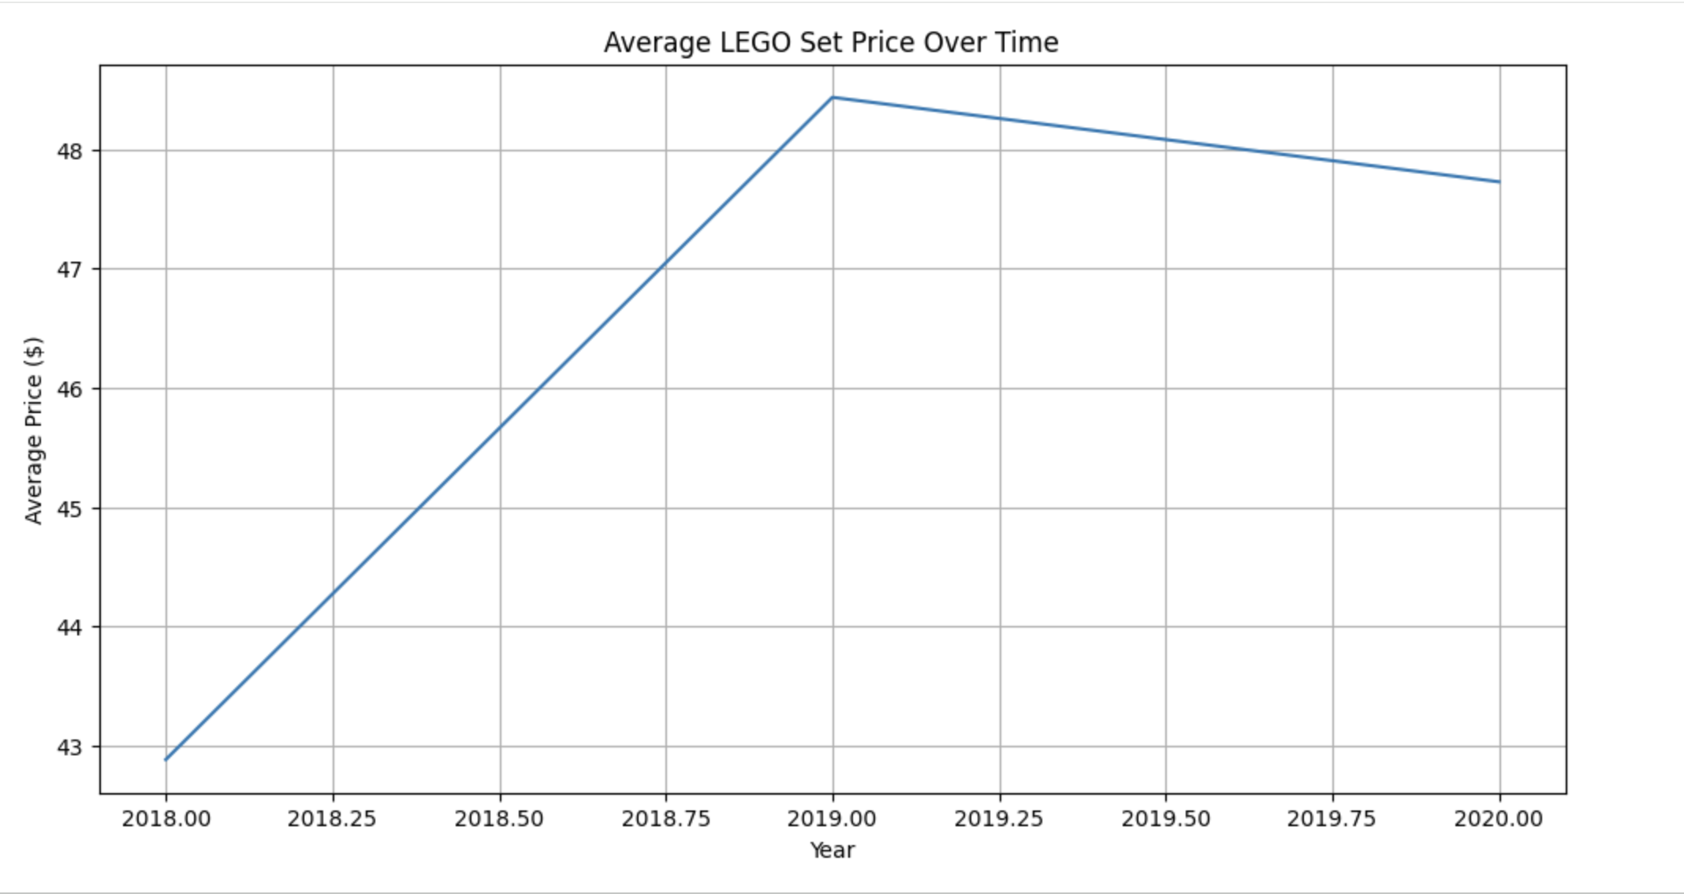
Findings (Average Price per Year)
Average Price of LEGO Sets:
2018: ~$42.9
2019: ~$48.4 (big increase)
2020: ~$47.7 (slight decrease)
Interpretation:
LEGO sets became more expensive overall
The largest jump happened from 2018 → 2019
Even with the small drop in 2020, prices stayed higher than in 2018

Slide 9
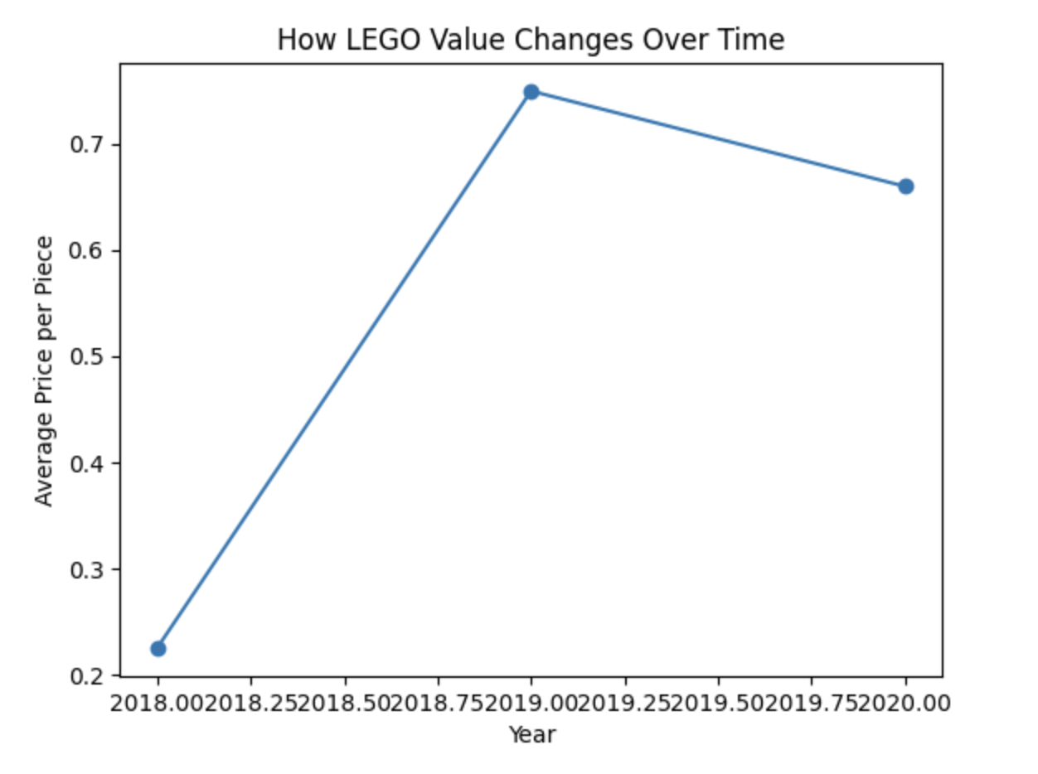
Findings (Price per Piece)
Average Price per Piece:
2018 = lowest price per piece
2019 = highest price per piece (worst value)
2020 = slight improvement, but still above 2018
Interpretation:
LEGO sets did not just get more expensive
The value per piece also decreased in 2019
2020 improved, but value didn’t return to 2018 levels

Slide 10
An Age-Based Pricing Analysis of LEGO Sets
Why this matters:
When buying LEGO gifts, parents often wonder:
"Why does this 8+ set cost so much more than this 6+ set?"
"Am I getting good value for older vs younger kids' sets?"
Impact:
Need to budget appropriately for birthdays and holidays
Understand LEGO's pricing strategy across age groups
Value Perception: Are older kids getting more or less value for money?
Market Insights: How does LEGO segment its market by age and price?

Slide 11
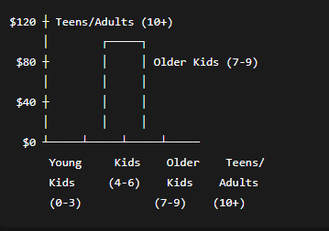
Data Prep and Key Metrics
Data Preparation:
  Analyzed 1,065 LEGO sets (2018-2020)
  Categorized into 4 age groups:
    Young Kids (0-3)
    Kids (4-6)
    Older Kids (7-9)
    Teens/Adults (10+)
Key Metrics:
  Average Price: Total cost of sets in each group
  Price per Piece: Price ÷ Number of pieces
  Comparison: Younger (0-6) vs Older (7+) groups
Formula Example: Price per Piece = Total Price ÷ Total Pieces in Age Group

Slide 12
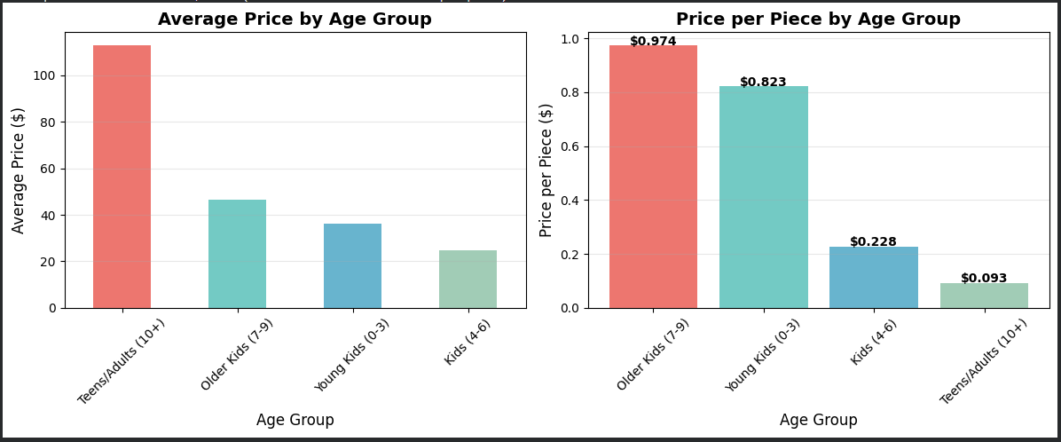
Findings and Key Discoveries
The Findings:
Older sets cost significantly more
  Teens/Adults sets average $112 vs Kids sets at $24
But price per piece tells a different story
  Younger kids get fewer pieces per dollar
Most expensive per piece
  Older Kids (7-9) at $0.97/piece
Best value per piece
  Teens/Adults (10+) at $0.09/piece
Price Increases Dramatically with Age:
Age Group | Average Price | Median Price | # of Sets
Teens/Adults (10+) | $112.84 | $69.99 | 147
Older Kids (7-9) | $46.56 | $39.99 | 422
Young Kids (0-3) | $36.27 | $19.99 | 71
Kids (4-6) | $24.82 | $19.99 | 425
Older = More Expensive

Slide 13
Data Prep and Key Metrics
Price Difference is Massive:
  Older kids' sets (7+) cost 140% more on average
  Direct comparison: $63.69 vs $26.46 for younger sets
Surprising Value Discovery:
  Teens' sets offer the best value per piece
  Older Kids (7-9) sets are the least cost-efficient
Why This Happens:
  Younger sets: Larger, simpler pieces focused on safety
  Older sets: More complex engineering, licensing fees, collector appeal
The Bottom Line:
Yes, LEGO sets for older kids are priced much higher but they often provide better building value despite the larger upfront cost.

Slide 14
Which LEGO themes have the lowest average price per piece?

Slide 15
Objective
Identify the most cost-effective LEGO themes based on average price per piece.
Key Insight:
The overall average price per piece is $0.1913, but many themes offer much better value, some under $0.10 per piece.
Value Categories:
High Value: < $0.0984 per piece
Medium Value: $0.0984 – $0.1762 per piece
Lower Value: > $0.1762 per piece

Slide 16
Top 10 Most Affordable LEGO Themes
Rank | Theme | Avg Price per Piece
1 | Classic | $0.069
2 | BrickHeadz | $0.075
3 | Speed Champions | $0.079
4 | Architecture | $0.082
5 | Ideas | $0.086
6 | Creator 3-in-1 | $0.089
7 | Unikitty!™ | $0.089
8 | Creator Expert | $0.096
9 | Hidden Side | $0.098
10 | Overwatch® | $0.100

Slide 17
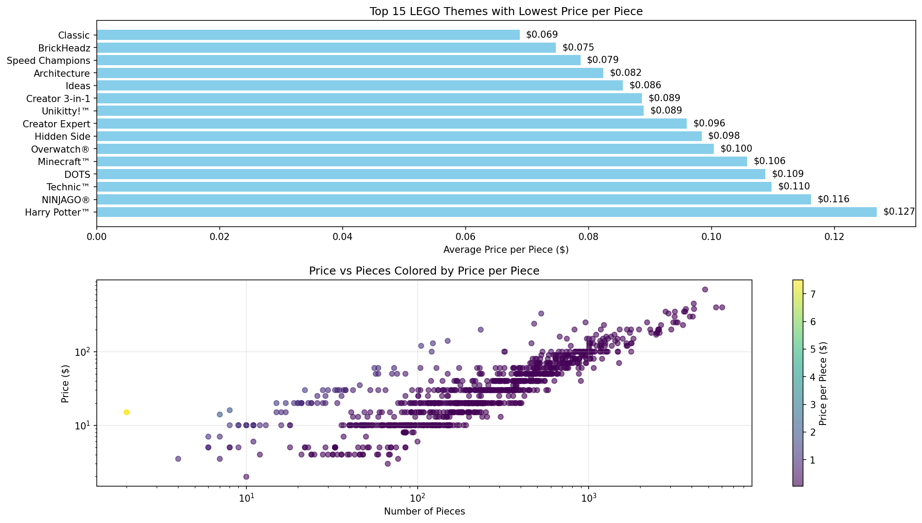

Slide 18
Key Takeaways
Summary of Findings:
Classic is the most affordable theme at $0.069 per piece.
Themes like BrickHeadz, Speed Champions, and Architecture also offer excellent value.
Large, complex sets (e.g., Creator Expert, Ideas) can still be cost-effective despite higher total prices.
Why Price per Piece Matters:
Helps identify budget-friendly building options.
Useful for gift buyers, collectors, and parents.
Does not account for piece size, complexity, or licensing costs.
Recommendations for Buyers:
Choose Classic or BrickHeadz for the best price-to-piece ratio.
Consider Speed Champions for affordable, detailed vehicle sets.
Explore Architecture and Ideas for premium yet value-rich builds.

Slide 19
Do sets with more piece's cost less per piece?
Are larger LEGO sets cheaper per piece?
Why this matters:
Consumers evaluate LEGO value using price per piece.
Understanding this relationship supports decisions on pricing, bundling, and marketing.

Slide 20
Key Question & Dataset
Research Question: Are larger LEGO sets cheaper per piece?
Goal: Determine whether pricing aligns with customer-perceived value.
Data fields used:
Pieces
Price
Theme
Size
Methodology:
Loaded LEGO dataset
Cleaned missing values for price and pieces
Created new metric:
Price per Piece = Price ÷ Pieces
Conducted:
Descriptive statistics
Scatterplot analysis
Regression trend line
Correlation calculation
Tools Used:
Google Colab
Python

Slide 21
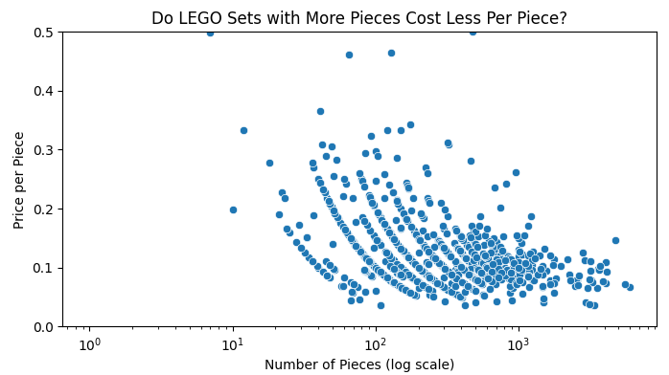
FINDING: PIECES VS. PRICE PER PIECE
Small sets cluster with high price-per-piece.
As piece count increases, price-per-piece drops.
Indicates a strong value difference between small and large sets.

Slide 22
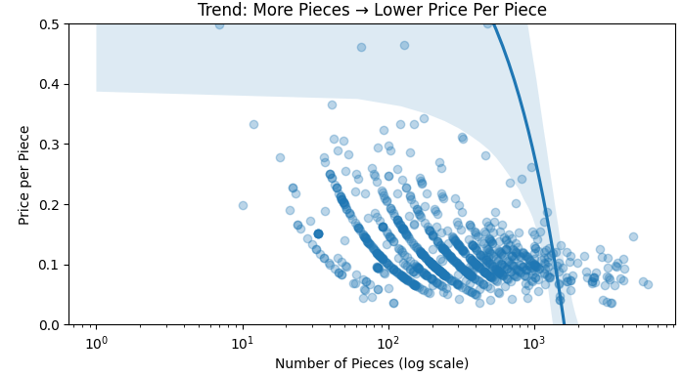
FINDING: MORE PIECES -> LOWER PRICE PER PIECE
Clear negative slope confirms a downward trend.
Higher piece counts consistently correlate with better value.
Confirms evidence of economies of scale.

Slide 23
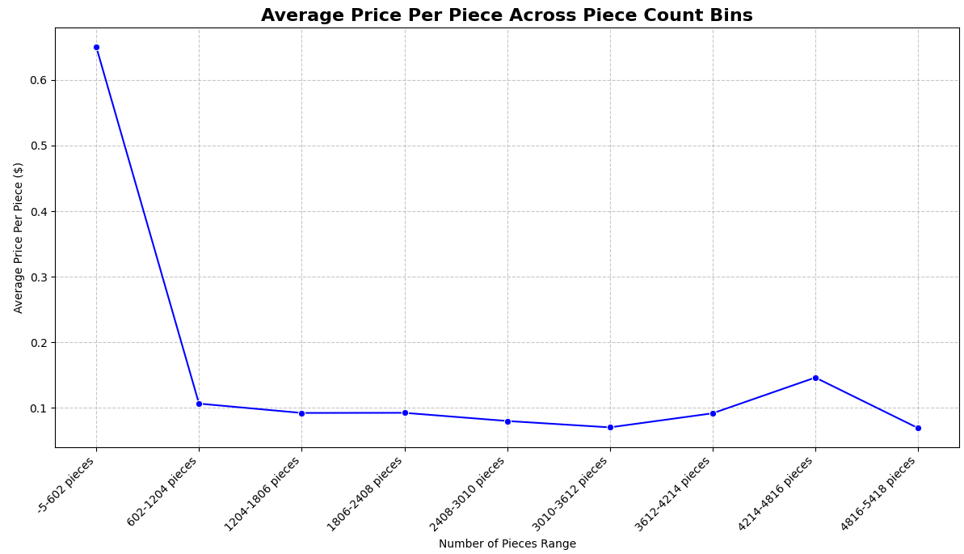
Recommendation for LEGO:
Leverage “Value-per-Piece” Pricing to Increase Profitability
Promote larger sets as better value to drive higher-margin purchases
Reevaluate pricing of small sets where price-per-piece is disproportionately high
Offer bundle packs to improve value perception on small/medium sets
Highlight “cost per piece” value messaging on Amazon listings
This line plot shows the average price per piece for sets falling into different piece count ranges. The general downward trend indicates that, on average, sets with more pieces tend to have a lower price per piece, confirming the observation from the scatter plot and summary statistics

Slide 24
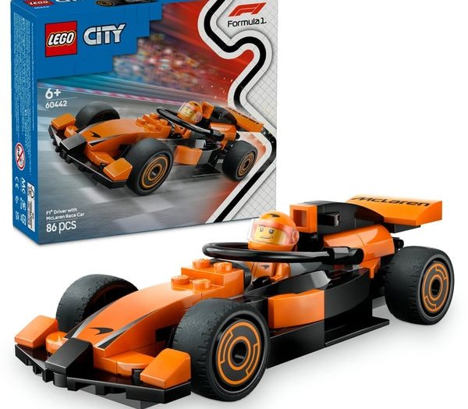
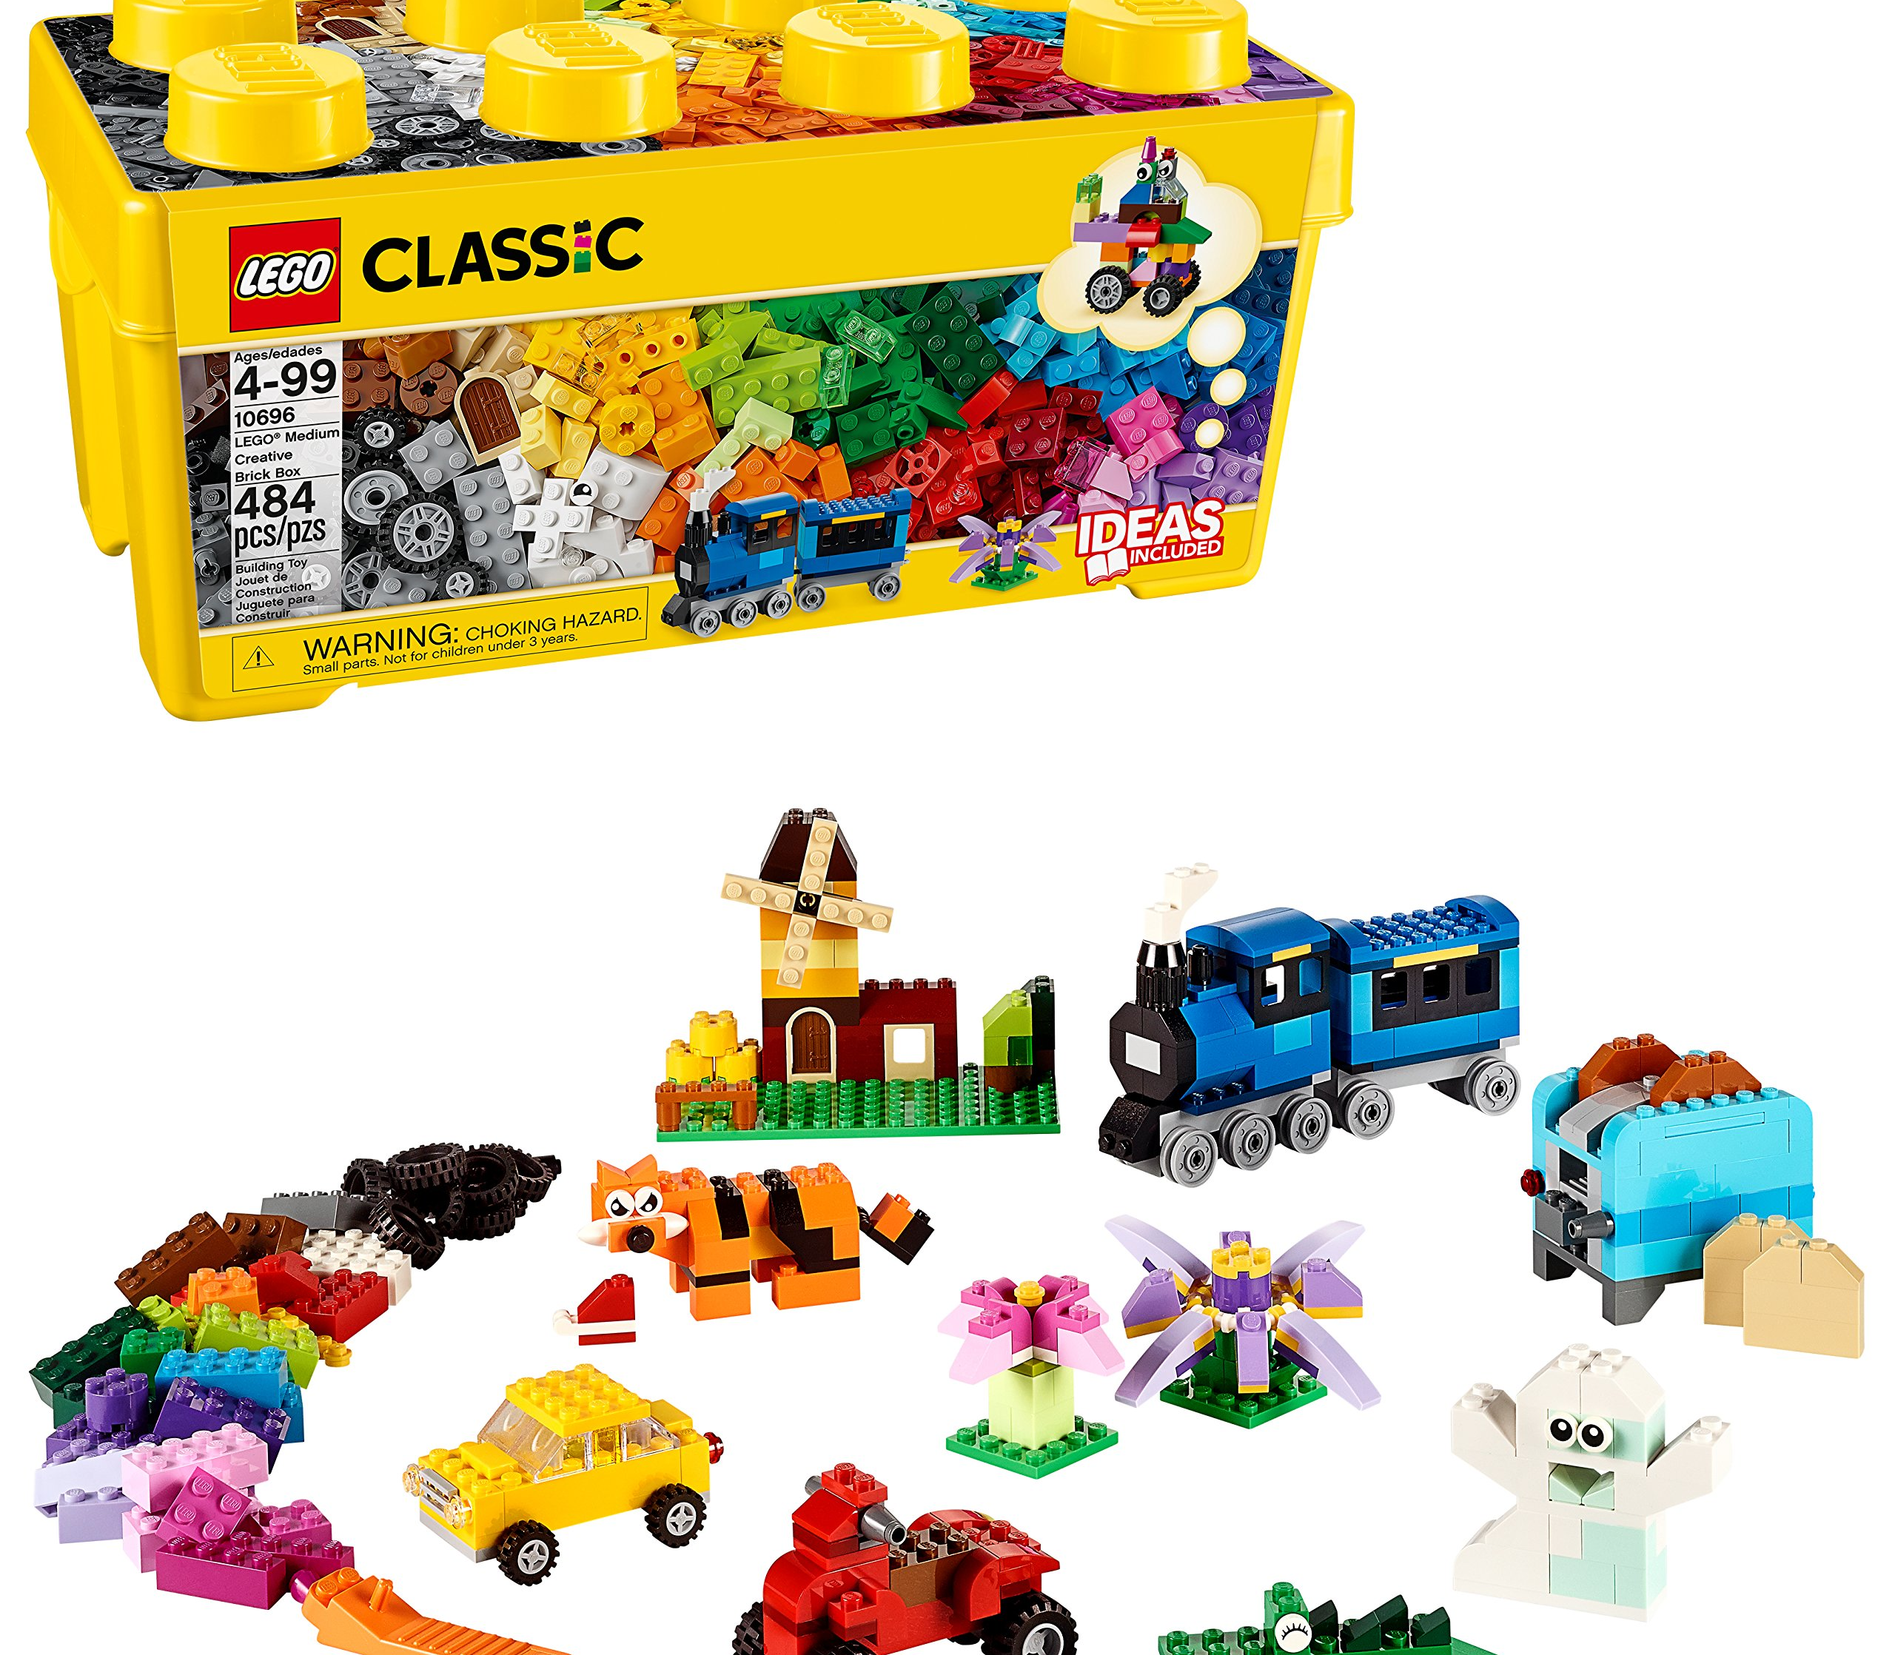
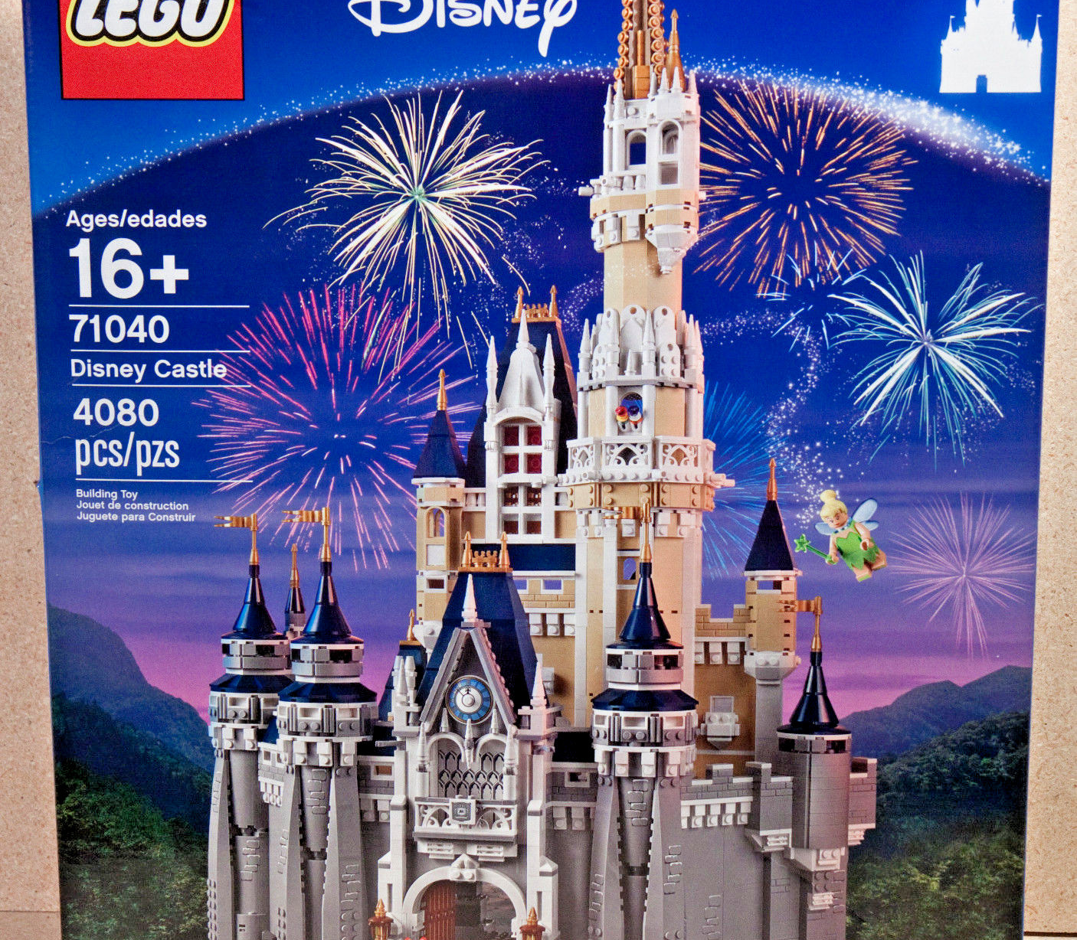
LEGO Set Size Analysis:
Small vs. Medium vs. Large
How Size Impacts Piece Count, Price, and Value

Slide 25
Question & Methodology
Core Question: How do Small/ Medium/ Large LEGO sets differ in:
Size Definition (Piece Count):
Methodology:
Total piece count
Total price
Price per piece (value)
Small: ≤ 68 pieces (33rd percentile)
Medium: 69–236 pieces (33rd–66th percentile)
Large: > 236 pieces (66th percentile)
Cleaned dataset (removed missing/invalid entries)
Categorized sets by piece count quartiles
Calculated averages + visualized trends

Slide 26
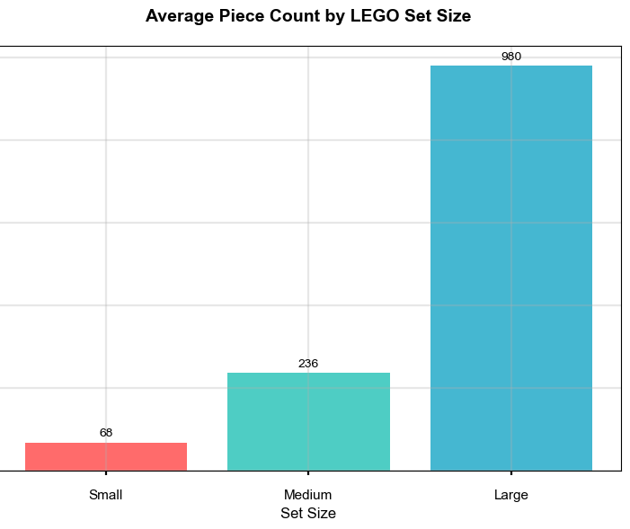
Finding 1: Average Piece Count by Set Size
Key Observation: Piece count scales dramatically with set size:
Small: 68 pieces (baseline)
Medium: 236 pieces (3.5x more than Small)
Large: 980 pieces (14x more than Small; 4.2x more than Medium)
Takeaway: Large sets deliver far more building content than smaller tiers.

Slide 27
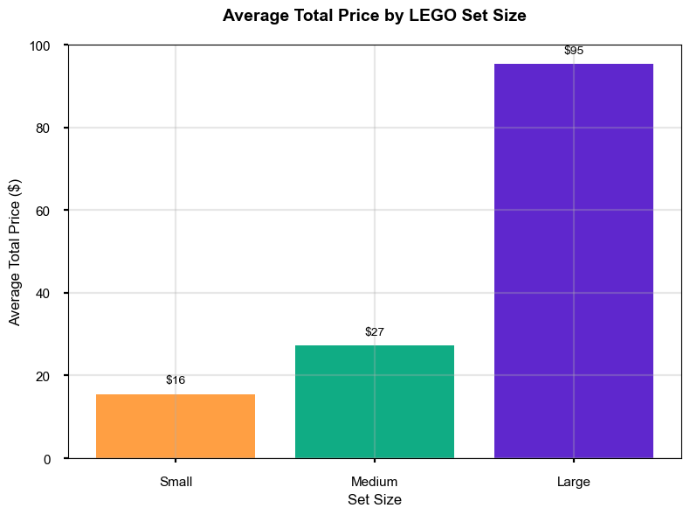
Finding 2: Average Total Price by Set Size
Pricing Trend: Total price rises with size, but not proportionally:
Small: $16 (baseline)
Medium: $27 (1.7x more than Small)
Large: $95 (6x more than Small; 3.5x more than Medium)
Insight: Large sets cost more upfront, but their price growth lags far behind piece count growth.

Slide 28
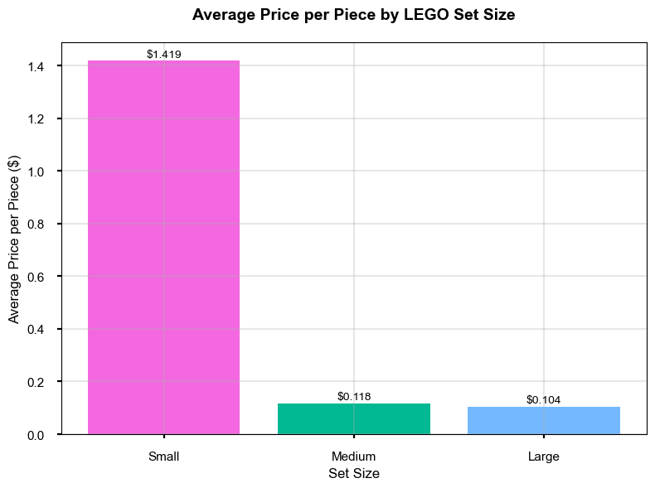
Finding 3: Average Price per Piece by Set Size
Value Breakdown: Price per piece drops sharply with larger sets:
Small: $1.419 (highest – 13.6x more than Large)
Medium: $0.118 (moderate)
Large: $0.104 (lowest – 93% better value than Small)
Critical Finding: Size is the biggest driver of value – larger sets are far more cost-efficient.

Slide 29
Business Implications & Recommendations
Set Size | Target Audience | Purchase Driver | Business Role
Small | Impulse buyers/gifters | Low price, quick build | Stocking stuffers/entry gifts
Medium | Casual families/builders | Balance of cost/pieces | Core repeat-purchase segment
Large | Dedicated fans/collectors | Complexity/value | High-margin premium offerings
Actionable Steps:
Market Small Sets as "Quick Gifts": Avoid value messaging; focus on convenience.
Expand Medium Set Options: Lean into their "sweet spot" of accessibility + value.
Highlight Large Set Value: Emphasize low price per piece to justify upfront cost.
Bundle Small Sets: Offer 2–3 small sets together to improve perceived value.

Slide 30


Q&A

